Slide 1
Circular Queues
Lecture #
By: Abdul Aleem

Slide 2


Contents
1
Motivation
2
Introduction
3
Basic Operations
4
References

Slide 3
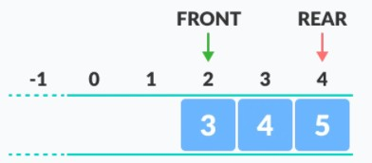
Motivation
There was one limitation in the array implementation of Queue. If the rear reaches to the end position of the Queue then there might be possibility that some vacant spaces are left in the beginning which cannot be utilized.
To overcome such limitations, the concept of circular queue was introduced.

Slide 4
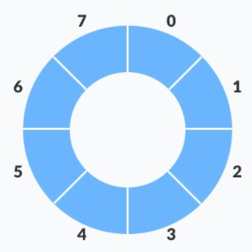
Introduction
A circular queue is the extended version of a regular queue where the last element is connected to the first element. Thus forming a circle-like structure.
Basic Operations:
Enqueue: Adding an item at the REAR of the queue. Dequeue: Removing an item from the FRONT of the queue.

Slide 5
Basic Operations: Insertion
Pseudo-code for Circular Queue Insertion:
Initailly, REAR = -1 and FRONT = -1.
insertCircularQueue(CQueue)
Step 1: If (REAR+1)%MAX == FRONT then,
Print ”Queue Overflow” and Return. Step 2: Else If FRONT == -1 and REAR == -1 then,
Set FRONT = REAR = 0.
Step 3: Else If REAR == MAX-1 AND FRONT!=0 then, Set REAR := 0.
Step 4: Else
Set REAR := (REAR + 1)%MAX.
Step 5: Set CQueue [REAR] := Item. Step 6: Exit

Slide 6
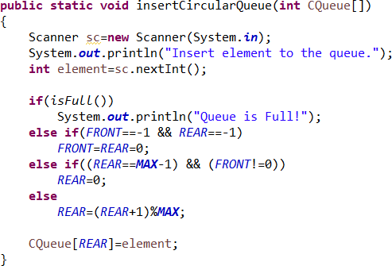
Basic Operations: Insertion
Java method for circular queue insertion

Slide 7
Displaying
Pseudo-code for displaying the Circular Queue:
displayCircularQueue(CQueue)
Step 1: If FRONT == -1 then,
Print ”Queue Underflow” and Return.
Step 3: Else
for i = FRONT to REAR Print CQueue[i].
Step 4: Exit

Slide 8
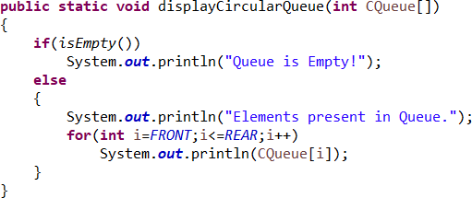
Displaying
Java method for displaying the circular queue

Slide 9
Basic Operations: Deletion
Pseudo-code for Deletion from Circular Queue:
deleteCircularQueue(CQueue)
Step 1: If FRONT == -1 then,
Print ”Queue Underflow” and Return.
Step 2: Else If FRONT == REAR then,
Set FRONT = REAR = -1 and Return.
Step 3: Else
Set Item := CQueue [Front]
Set FRONT := (FRONT + 1)%MAX.
Print Item.
Step 4: Exit

Slide 10
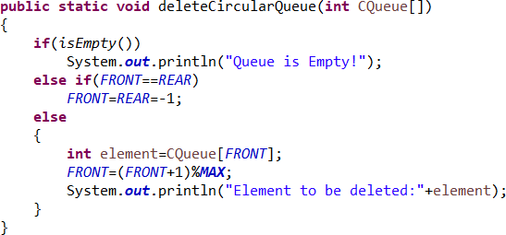
Basic Operations: Deletion
Java method for deletion from circular queue

Slide 11
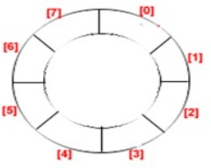
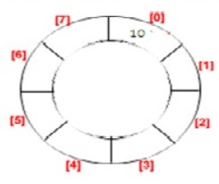
Basic Operations: Example
Suppose that we have an array of size MAX = 8. The status of the array on performing different queue operations are given below:
(a) Initially empty:
(b) Add item 10: [FRONT = 0, REAR = 0]

Slide 12
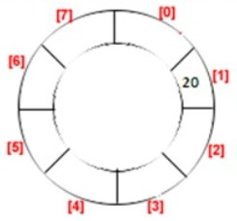
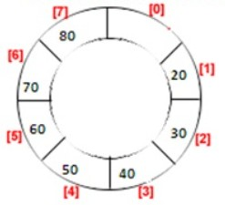
Basic Operations: Example
(c) Delete one item: [FRONT = 1, REAR = 1]
(d) Insert 6 more items: [FRONT = 1, REAR = 7]

Slide 13
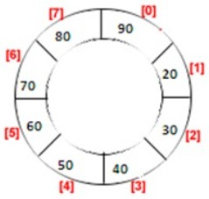
Basic Operations: Example
Now, in case of linear queue, we cannot access the [0] block for insertion. But, in case of circular queue the next item will be inserted into the [0] block.
(e) Insert 90: [FRONT = 1, REAR = 0]

Slide 14
References
[1] Michael T. Goodrich, Roberto Tamassia, Michael H. Goldwasser ‘Data Structures and Algorithms in Java’, Wiley, 2014.

